Slide 1
Marquise Knox
Born St. Louis, Mo, Marquise hails from a musical family deeply rooted in the Blues. He learned how to play guitar from his grandmother Lillie. He also played with his uncle Clifford, who was a major influence in Marquise's life. For Marquise, Blues is his heritage and way of life. He spent his early teenage years in St. Louis mentoring under the late great Blues legend, N.E.A. (National Endowment of the Arts) Heritage Fellowship recipient and Grammy Award winner Henry James Townsend. Marquise's talents have earned him performing rights with some of America’s most notable blues performers such as blues legends B.B. King, Pinetop Perkins and David “Honeyboy” Edwards (the latter two also N.E.A. Heritage Fellows). He has also performed at dozens of festivals, and has toured all throughout Europe.
During a visit to Clarksdale, Mississippi, Marquise was introduced to Sam Lay. Like other statesmen of the Blues, Sam took an immediate liking to Marquise and took it upon himself to help give Marquise's career a boost by insisting that Chad Kassem bring Marquise to the celebrated Blues series "Blues Masters at the Crossroads," which has showcased a virtual who's-who of the Blues at Blue Heaven Studios in Salina, Kansas. Marquise was an immediate crowd favorite, and was adopted by all of the elders of the Blues in attendance that year. His obvious talent along with his deep knowledge of the Blues and vast respect for his elders made it clear Marquise had something special
Knox’s debut album MANCHILD was nominated for a Blues Music Award for Best New Artist Debut. The album was recorded when he was 16 with world renowned guitarist Michael Burks and his band. The release received worldwide acclaim, including Living Blues' Best Debut Artist Award and a Blues Music Award nomination for Best Debut Artist. Marquise then recorded a direct-to-disc album while in town for the next year's Crossroads. Marquise released his second album, Here I Am, once again recorded at the legendary Blue Heaven Studios in Salina, Kansas. Nine originals, and three reverent covers of Marquise’s favorite Muddy Waters tunes .
In 2017 Marquise formed his own independent label Knox Entertainment and released his first self produced album Black & Blue Live!

Slide 2
Festivals
2017 NHL winter Classic Game
King Biscuit Blues Festival
Tampa Bay Blues Festival
Harvest Jazz & Blues Festival
Granhuns Jazz Festival
Recife Beat Festival
Waterfront Blues Festivals
Luzern Blues Festival
Richmond Folk Festival
Lowell Folk Festival
Big Muddy Blues Festivals
Montana Folk Festival
Cognac Blues Passions Festival
Edinburgh Jazz & Blues Festival
Mississippi Valley Blues Festival
Chicago Blues Festival
Jazz A Vienne Festival
Calgary International Blues Festival
75th and 78th National Folk Festival
Briggs Farm Blues Festival

Slide 3
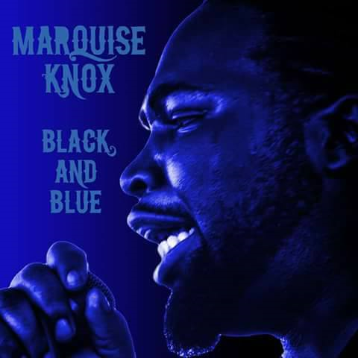
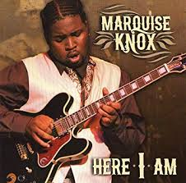
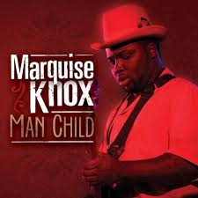
Videos & Discography

